Slide 1
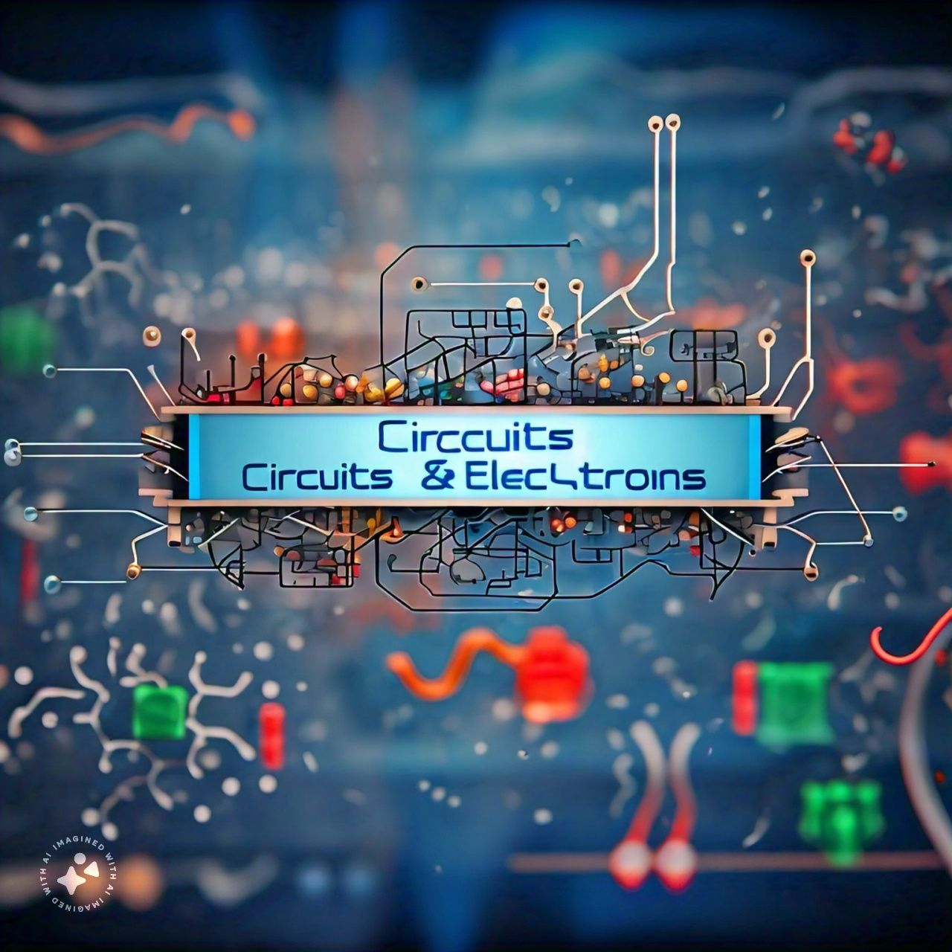
Clamper Circuit

Slide 2

Clamper Circuit
A Clamper circuit can be defined as the circuit that consists of a diode, a resistor and a capacitor that shifts the waveform to a desired DC level without changing the actual appearance of the applied signal.
It is also known as a DC restorer or level shifter.

Slide 3
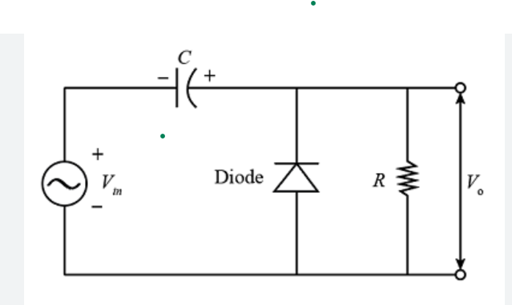
R is the resistance of the resistor employed
C is the capacitance of the capacitor used
D is the diode
Vin is the input voltage

Slide 4
Types Of Clamper Circuit
There are Few Types of Clamper Circuit
Positive Clamper
Negative Clamper
Biased Clamper

Slide 5
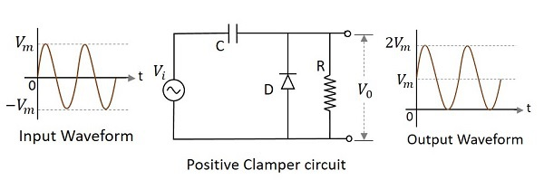
Positive Clamper Circuit
Shifts its input waveform in a positive direction
Lies above a dc reference voltage.
V0=Vi+Vm

Slide 6
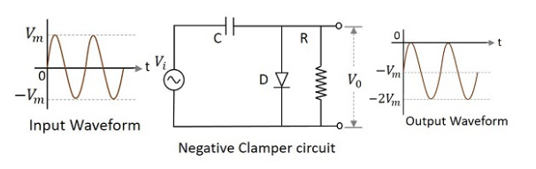
Negative Clamper Circuit
Shifts its input waveform in a negative direction
Lies below a dc reference voltage.
V0=Vi+Vm

Slide 7
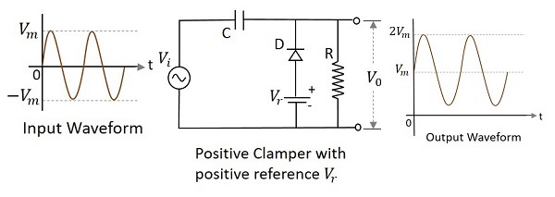
Positive biased with positve clamper
If biased with some positive reference voltage, that voltage will be added to the output to raise the clamped level.

Slide 8
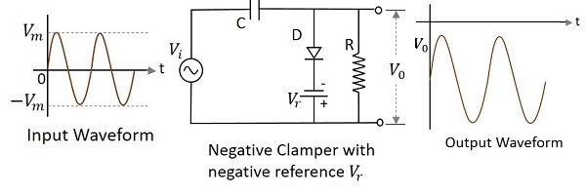
Negative biased with negative clamper
If biased with some negative reference voltage, that voltage will be added to the output to raise the clamped level.

Slide 9
Applications
There are many applications for Clampers such as
Voltage Multipliers: Clamper circuits are used in voltage multiplier circuits to produce high voltage DC outputs.
2. TV and Radio Circuits: Clamper circuits are used in TV and radio circuits to restore the original DC level of the signal.

Slide 10
Applications
3. Medical Equipment: Clamper circuits are used in medical equipment such as ECG machines to shift the baseline of the signal to a desired level.
4. Data Acquisition Systems: Clamper circuits are used in data acquisition systems to shift the signal to a desired level for processing.
5. Audio Equipment: Clamper circuits are used in audio equipment such as amplifiers and filters to shift the signal to a desired level.

Slide 11
Thank You

